Slide 1

Introduction to Multithreading

Slide 2
What is Multitasking?
Multitasking is synonymous with process-based multitasking, whereas multithreading is synonymous with thread-based multitasking
All modern operating systems support multitasking
A process is an executing instance of a program
Process-based multitasking is the feature by which the operating system runs two or more programs concurrently

Slide 3

Example
You might have come across people doing multiple things at the same time: A person talking on the phone while having lunch or watching TV
In a computer, you can run multiple programs at the same time. Like you can play a song using Media Player while typing a Word document

Slide 4
What is Multithreading?
In multithreading, the thread is the smallest unit of code that can be dispatched by the thread scheduler
A single program can perform two tasks using two threads
Only one thread will be executing at any given point of time given a single-processor architecture

Slide 5
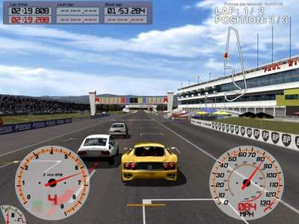
Example
Computer games are best examples of multithreading
You might have seen that in most of the ‘race’ games,other cars or bikes will be competing with your car/bike. These are nothing but threads.

Slide 6

Example
Imagine that you need to paint your house. You can employ one painter who will take 5 days to complete the work or you can employ 5 painters who will finish the work in one day.
In this case the 5 painters will be painting at the same time. That is 5 threads will be executing at the same time.
5 Threads
Single Thread

Slide 7

Example
When you start typing in a MS Word document, you can see that the incorrectly spelled words are underlined with a red wavy line. Like:
This is done by spell check feature of MS Word. The spell check is running in parallel while we type in a Word document. This is handled by a separate thread.

Slide 8
Multitasking Vs. Multithreading
Compared to multithreading, multitasking is characterized by the following:
• Each process requires its own separate address space
• Context switching from one process to another is a CPU- intensive task needing more time
• Inter-process communication between processes is again expensive as the communication mechanism has to span separate address spaces
These are the reasons why processes are referred to as heavyweight tasks

Slide 9
Multitasking Vs. Multithreading(Contd.).
Threads cost less in terms of processor overhead because of the following reasons:
– Multiple threads in a program share the same address space and they are part of the same process
– Switching from one thread to another is less CPU- intensive
– Inter-thread communication, on the other hand, is less expensive as threads in a program communicate within the same address space
Threads are therefore called lightweight processes

Slide 10
Uses of Multithreading
A multithreaded application performs two or more activities concurrently
It is accomplished by having each activity performed by a separate thread
Threads are the lightest tasks within a program, and they share memory space and resources with each other

Slide 11
References
© 2012 WIPRO LTD | WWW.WIPRO.COM (wipro TalentNext resources)

